Slide 1
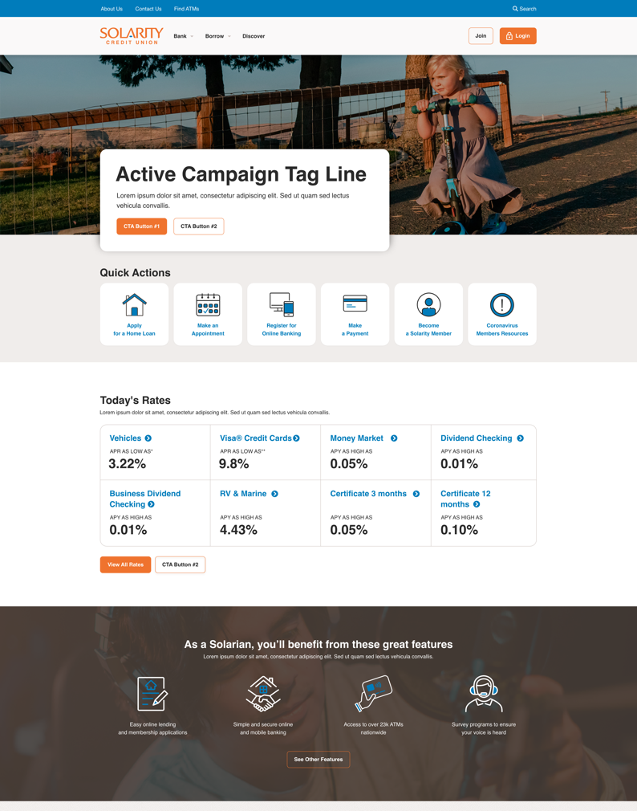
Solarity Credit Union
solaritycu.org
Business Need
Solarity Credit Union was looking to redesign its website, migrating to the Sitefinity platform. The project goal was to enhance user experience, integrate necessary functionalities, and ensure responsive and accessible design. Integration with Salesforce, Cloudflare, third-party plugins and online banking system were also critical features.
Results
The redesigned website for Solarity Credit Union on the Sitefinity platform enhanced user experience with improved navigation, integrated essential functionalities, and ensured a responsive, accessible design. The project was completed with thorough testing, training, and support, establishing a top-tier online presence for Solarity Credit Union. This project showcases Affirma Consulting's capability to deliver a complex and integrated website design projects, meeting both functional requirements, UX and design goals.

Slide 2
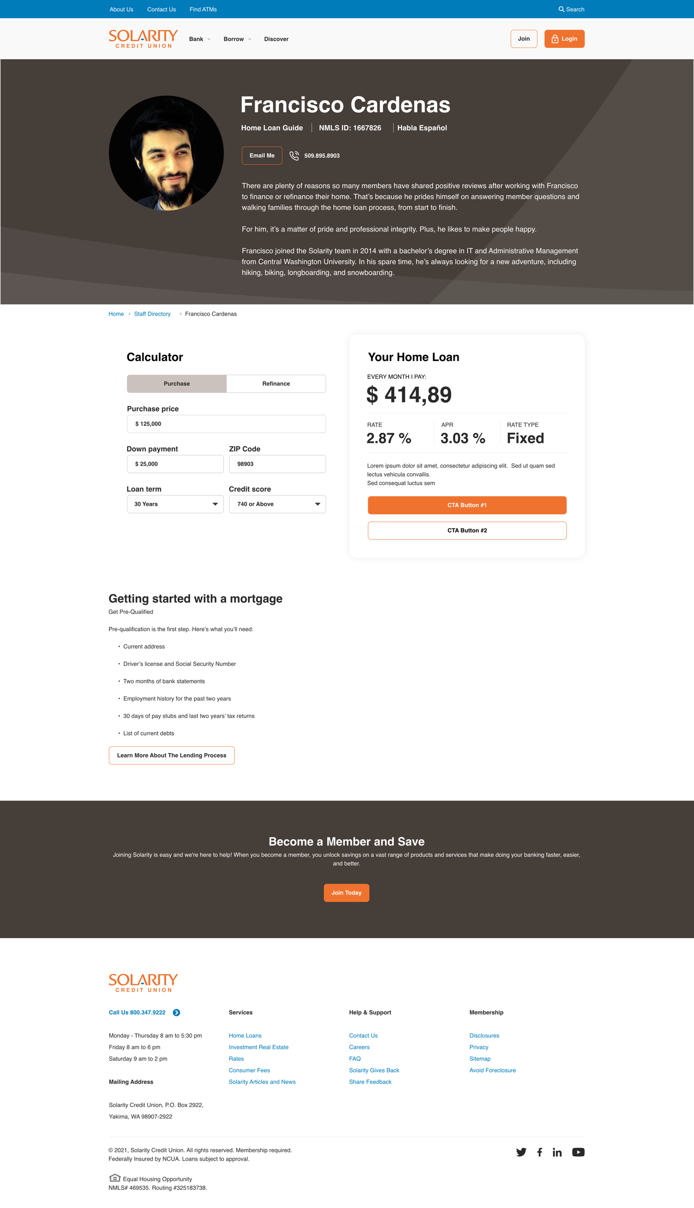
Solarity Credit Union
solaritycu.org
What We Did
Wireframes Developed wireframes for mobile and desktop views, covering various pages like the homepage, product pages, contact page, rates page
Visual Designs Applied existing branding to the wireframes, reviewed in two rounds, and handed off to the development team.
Environment Setup Set up the development environment, including navigation, content types, and online banking login integration.
Content and Components Built content templates and components for the homepage, product pages, landing pages, and more. Included global styles, notifications, forms, and static product comparisons.
Integration Integrated Optimal Blue for rate tables, Salesforce for form submissions, and existing systems like MoneyPass and Cloudflare.
Custom Functionality Added a rate calculator widget, customized search page, FAQ page with a rich content editor, and staff directory with scheduling integration.
QA Testing Conducted comprehensive QA testing for functionality and design. Ensured accessibility standards were met while fixing identified bugs.
Launch & Training Deployed the site and provided training sessions for Solarity’s content creators and ongoing support and maintenance through managed services.

Slide 3
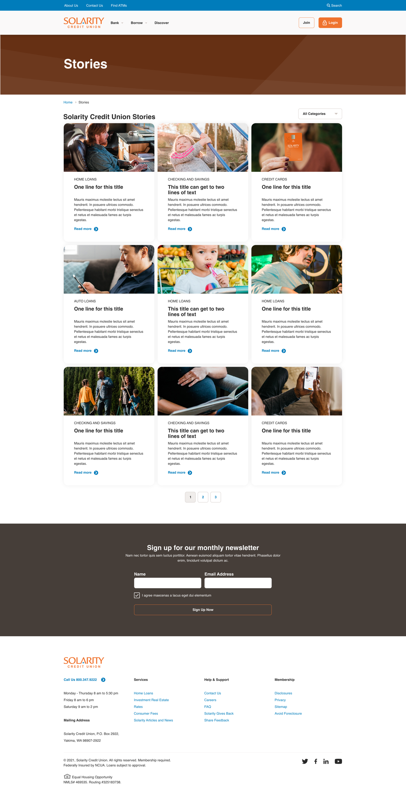
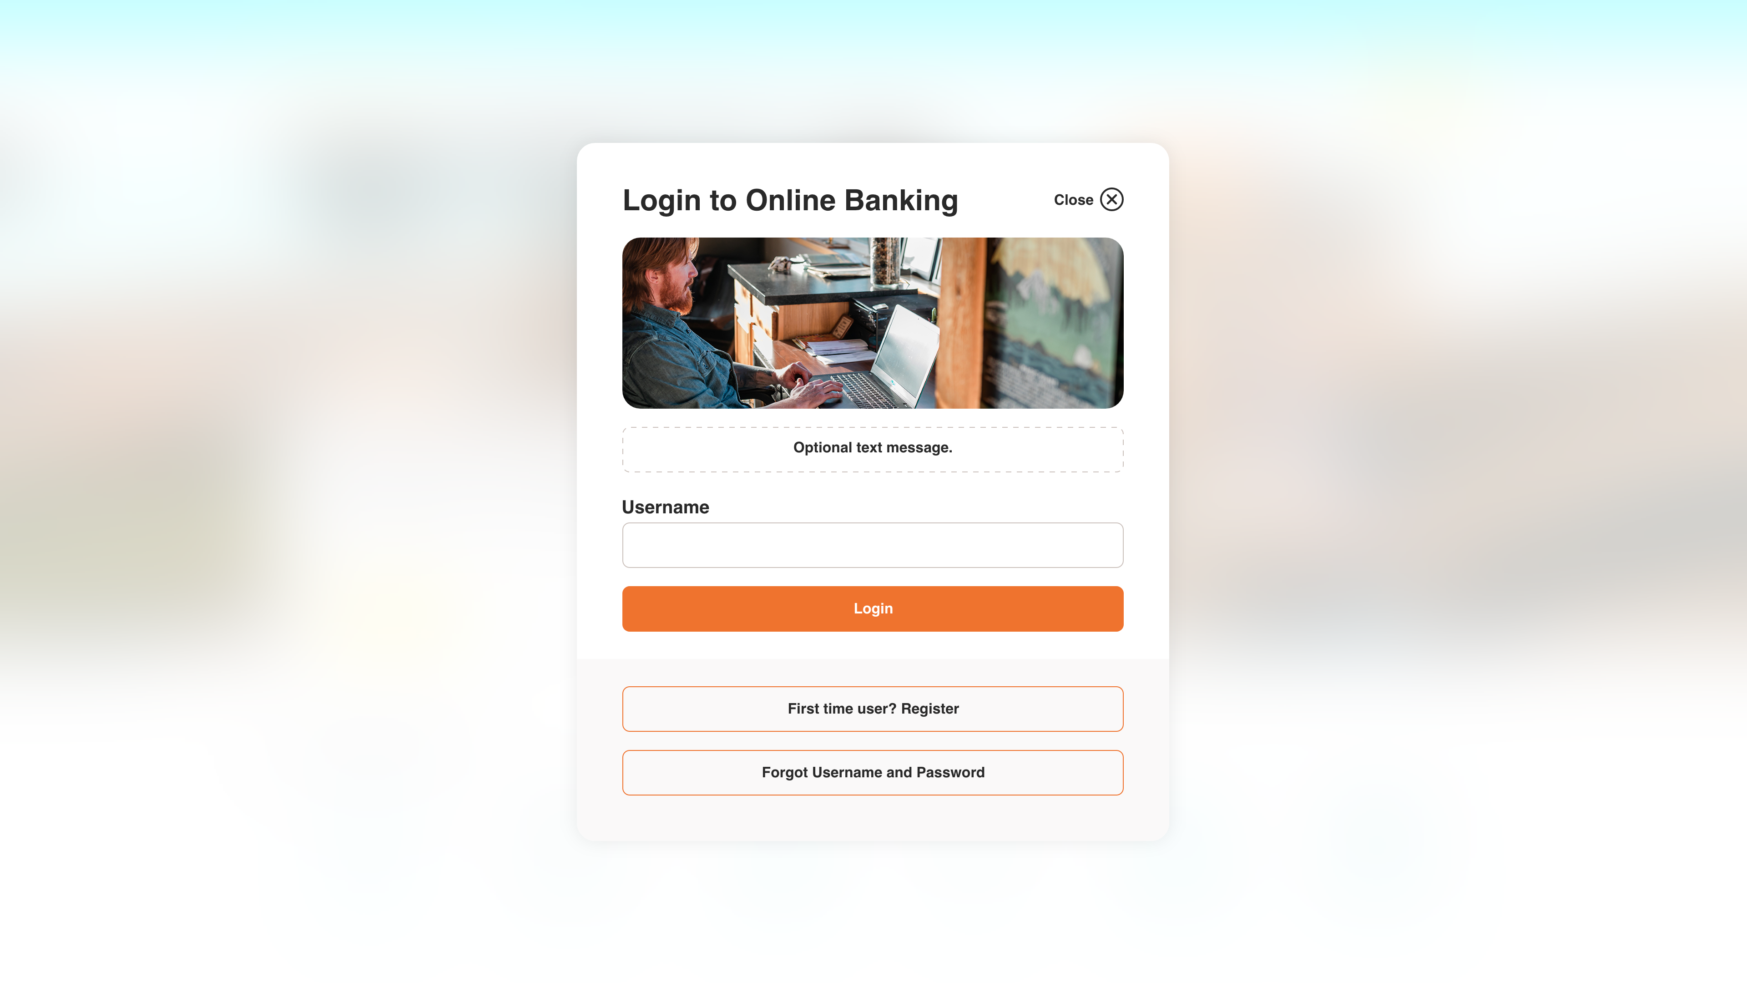
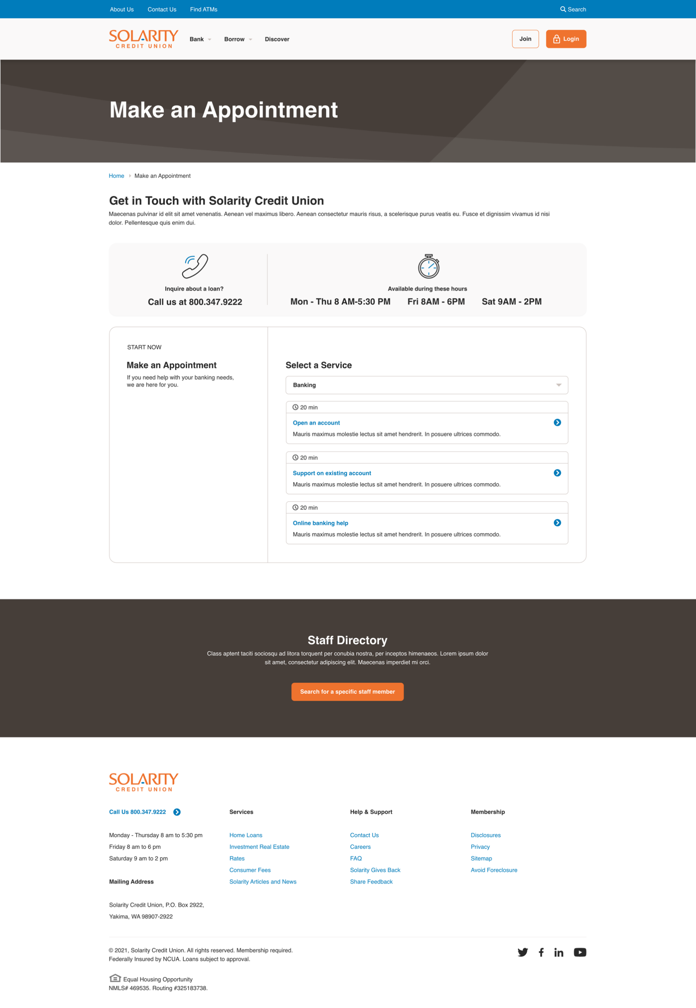
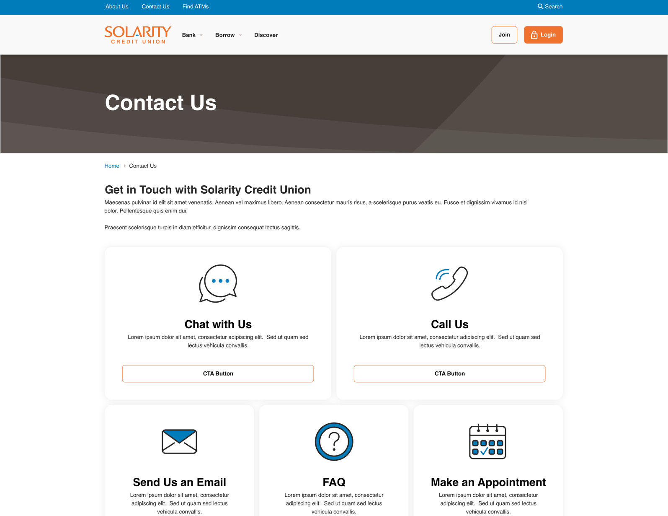
Solarity Credit Union

